Slide 1
WELCOME TO THE DEPARTMENT
Department of Instrumentation and Control Engineering
ICE 2154 NETWORK ANALYSIS AND SIGNALS
Dr. Dayananda Nayak
daya.nayak@manipal.edu Mob: 9448623805

Slide 3

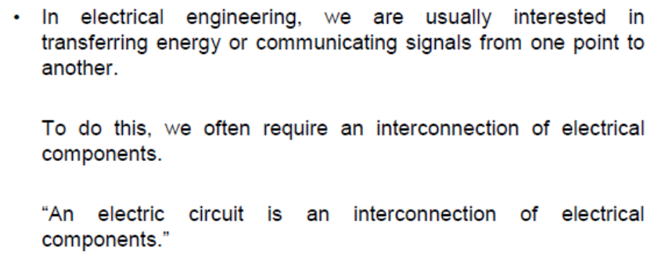

Slide 9
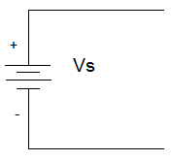
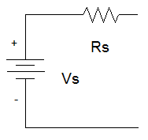
Voltage Sources
Ideal
Real
An ideal voltage source has no internal resistance.
It can produce as much current as is needed to provide power to the rest of the circuit.
A real voltage sources is modeled as an ideal voltage source in series with a resistor.
There are limits to the current and output voltage from the source.

Slide 10
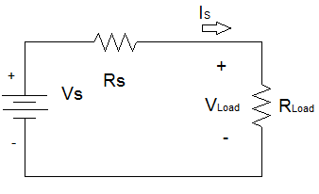
I_{L}
R_{L} = ∞Ω
R_{L} = 0Ω

Slide 11
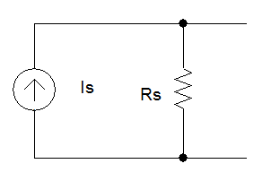
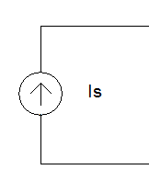
Current Sources
Ideal
Real
An ideal current source has no internal resistance.
It can produce as much voltage as is needed to provide power to the rest of the circuit.
A real current sources is modeled as an ideal current source in parallel with a resistor.
Limitations on the maximum voltage and current.

Slide 12
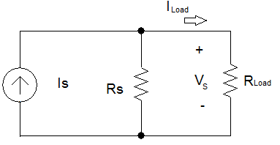
Appear as the resistance of the load on the source approaches Rs.
I_{L}
V_{L}
R_{L}
Real Current Source
R_{L} = 0Ω
R_{L} = ∞Ω

Slide 13
Sources when set to Zero
Current Sources
Voltage Sources
+
Vs=0 Ξ Short
- Circuit
Is Ξ Open
Circuit

Slide 32
References
http://pongsak.ee.engr.tu.ac.th/le325/NetworkTheorem.pdf
http://bapirajueca1.blogspot.com/2017/03/unit-6-network-theorems-ppt.html?m=1
https://www.iare.ac.in/sites/default/files/PPT/IARE_EC_PPT_1.pdf

